Slide 1


Leveraging Koopman operator and Deep Neural Networks for Parameter Estimation and Future Prediction of Duffing oscillators. Y. Riyazi, N. Ghanbari, A. Bahrami Mechanical Engineering department, University of Tehran y.riyazi@ut.ac.ir

Slide 2
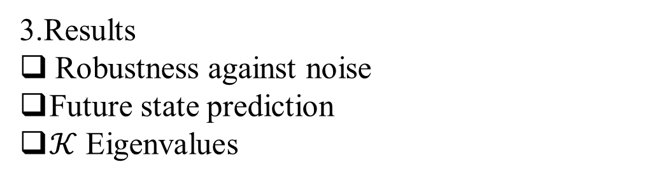
Outline
1.Introduction
Literature review
The Koopman Operator
Numerical data (dataset)
2.Network
Structure
Encoder
The Koopman Evolution Matrix
Encoder and Normalization
Linear layer –Stage II
3.Results
Robustness against noise
Future state prediction
$𝒦$ Eigenvalues

Slide 3
Introduction: Dynamical Systems Modeling
Approaches for encountering the dynamical system
Newton –Analytical view
Poincare –Phase Plane
Prior knowledge of system is required
Koopman –Infinite dimensional
Bifurcation data-driven
Robustness

Slide 4
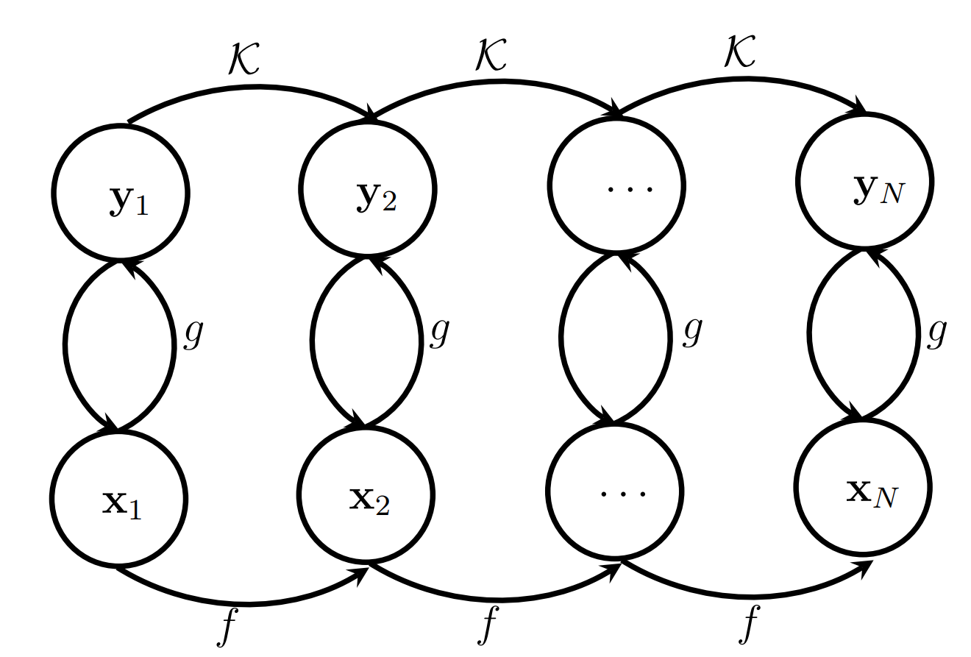
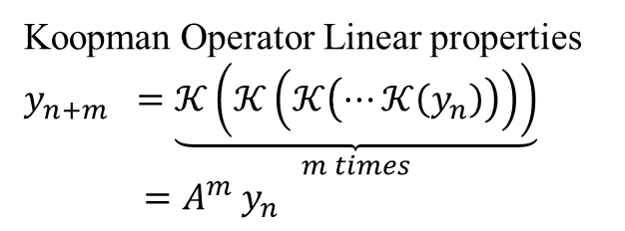
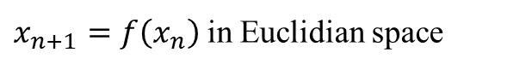
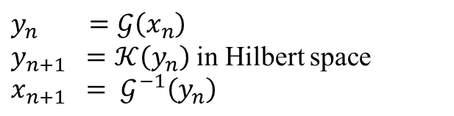
Introduction: Literature review
1931 –Bernard O. Koopman –“Hamiltonian Systems and Transformations in Hilbert Space.”
$$y_{n} =𝒢\left(x_{n}\right)$$
$y_{n+1} =𝒦\left(y_{n}\right)$ in Hilbert space
$$x_{n+1} = 𝒢^{−1}\left(y_{n}\right)$$
Koopman Operator Linear properties
$$y_{n+m} =\underset{m times}{\underbrace{𝒦\left(𝒦\left(𝒦\left(⋯𝒦\left(y_{n}\right)\right)\right)\right)}}$$
$=A^{m}$ $y_{n}$
$x_{n+1}=f\left(x_{n}\right)$ in Euclidian space
Figure 1. The Koopman Operator.

Slide 5
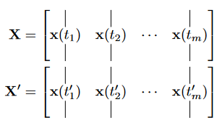
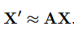
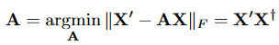
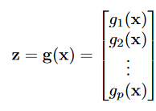
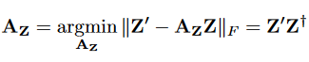
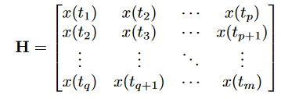
Introduction: Literature review
2009 –Peter J. Schmid –“Dynamic mode decomposition of numerical and experimental data.”
2015 –Matthew O. Williams – “A data-driven approximation of the Koopman operator: Extending dynamic mode decomposition.”
2019 – Enio Vasconcelos Filho –“A Dynamic Mode Decomposition Approach With Hankel Blocks to Forecast Multi-Channel Temporal Series”

Slide 6
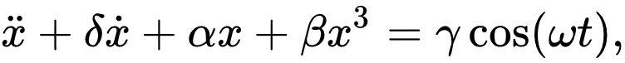
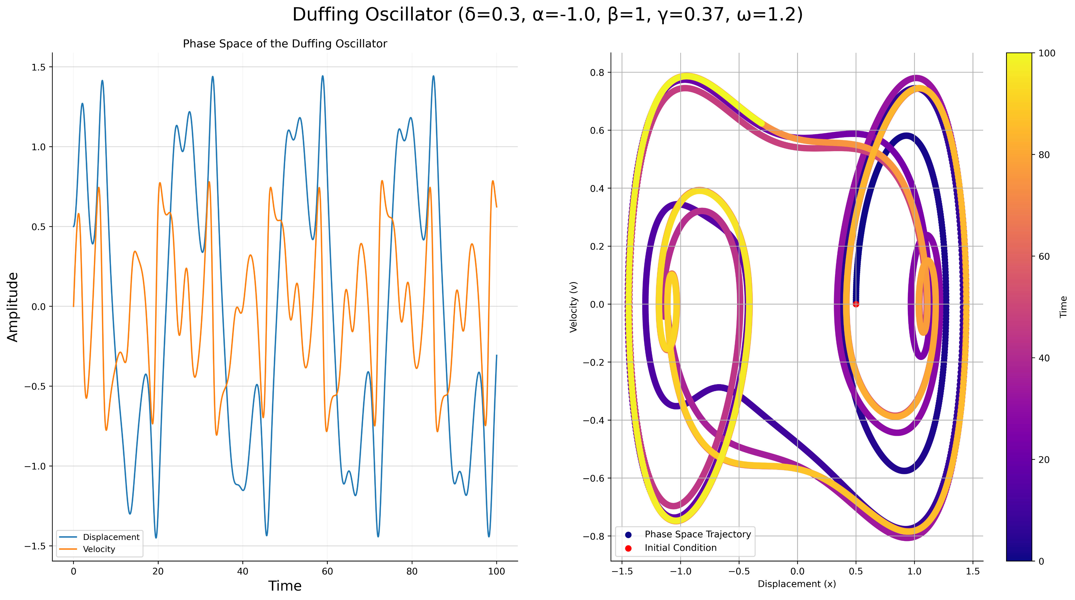
Introduction: Numerical data (dataset)
Figure 2. Numerical result of Duffing oscillator.

Slide 7
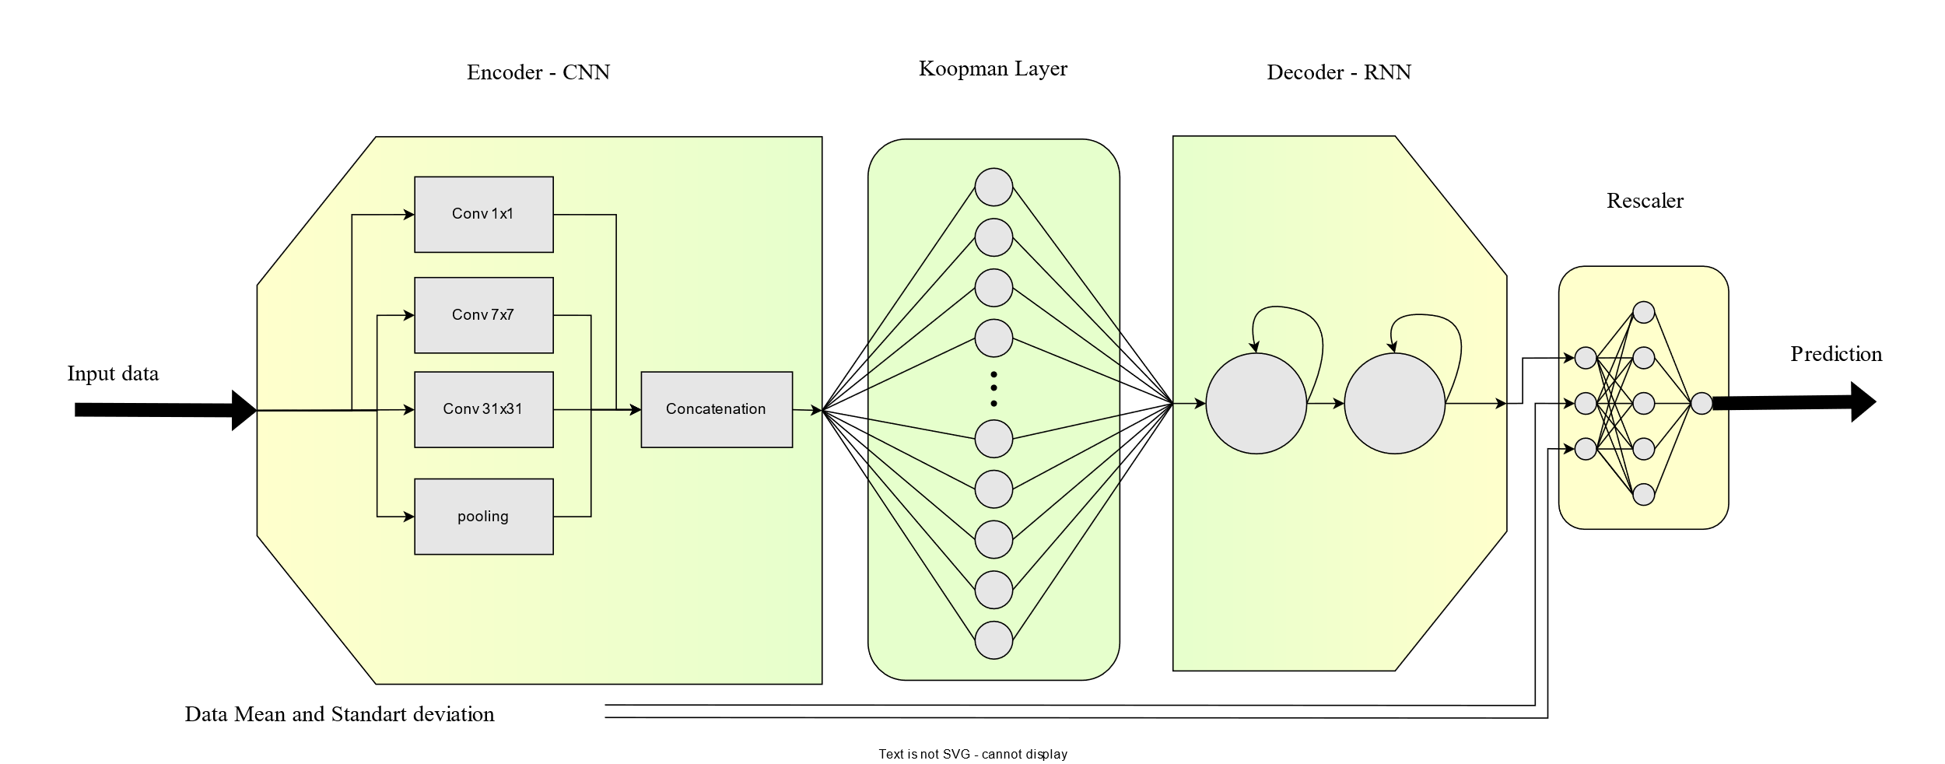
Network: Structure
Figure 3. Network’s Diagram.

Slide 8
Network: Encoder
CNN
Similar to Frequency transformations
Considering different Time scales with different Convolutional filter size.
Inception
Considering different Time scales with different Convolutional filter size.
Not dependent to input size
Improving Back propagation Flow
Autoregressive generation produces the output sequentially, while encoding occurs only once.
Figure 4. Network’s Diagram.

Slide 9
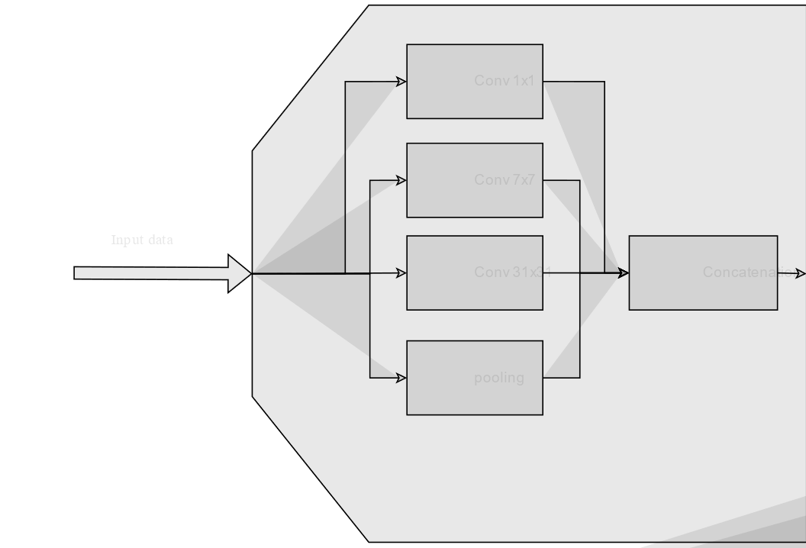
Network: The Koopman Evolution Matrix
This layer designed to serve as the Koopman operator evolution matrix.
NO Bias.
NO Activation Function !!!
Figure 5. Network’s Koopman Linear Layer.

Slide 10
Network: Encoder and Normalization
Figure 6. Network’s structure –Rescaler.

Slide 11
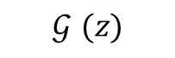
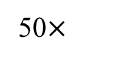
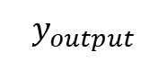
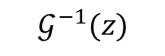
Network: Linear layer –Stage II
50$×$
According to Koopman Operator theory, the evolution matrix is a
$$𝒢^{−1}(z)$$
$$ℒ\left(A^{50}y_{n},𝒢^{ }(y_{n+50})\right)$$
$$y_{output}$$
$$𝒢^{ }(z)$$
Figure 7. Network’s Koopman Linear Layer.

Slide 12
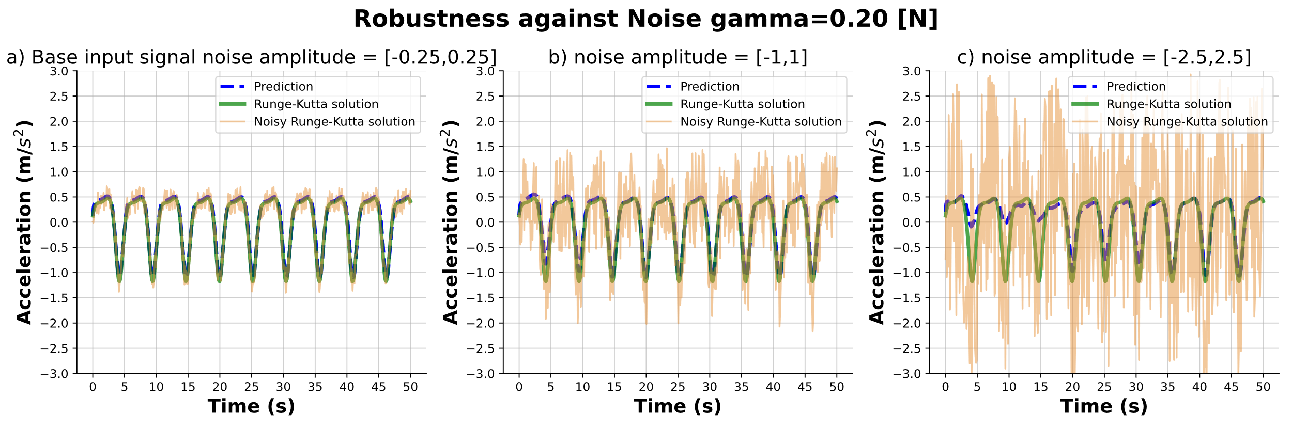
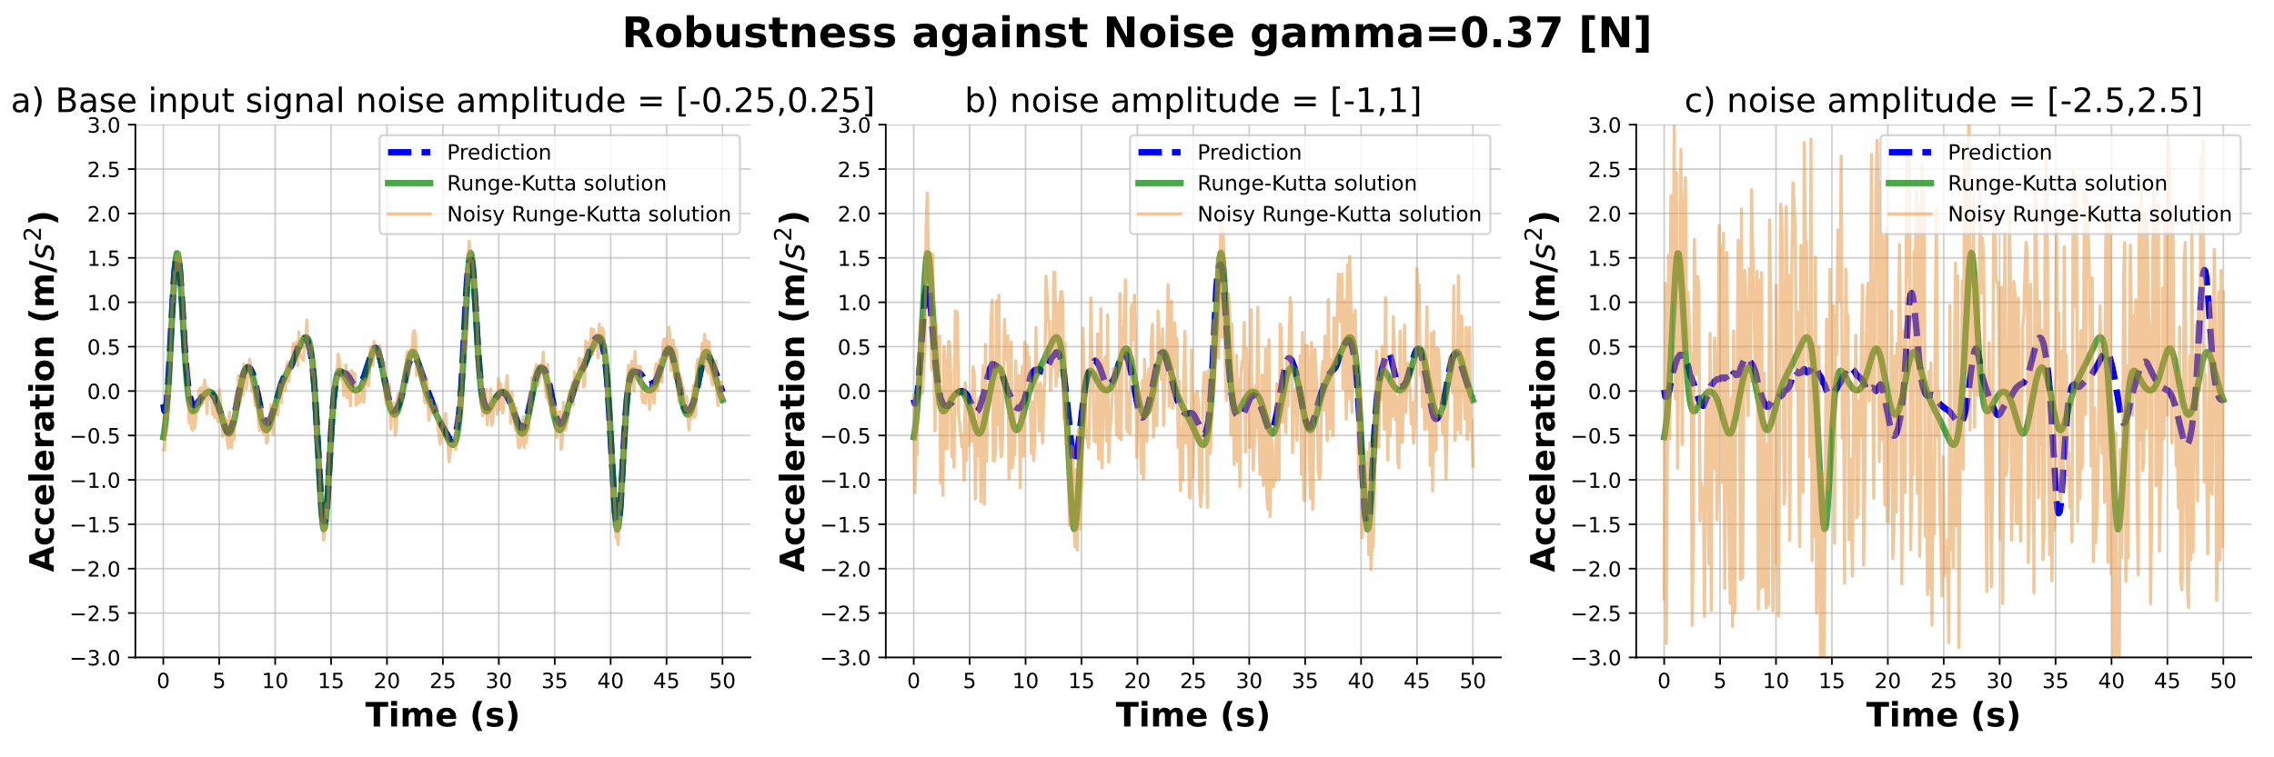
Results: Future state prediction
Accuracy and loss criteria
MSELoss: 0.0023

Slide 13
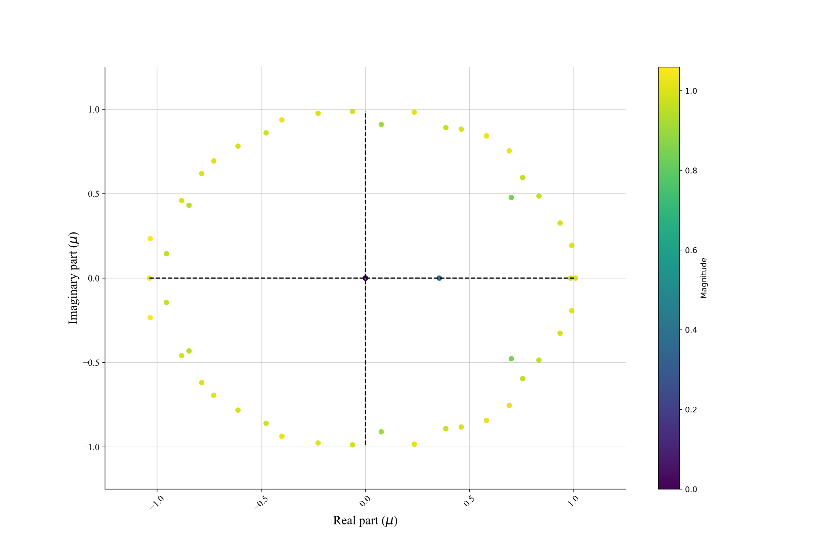

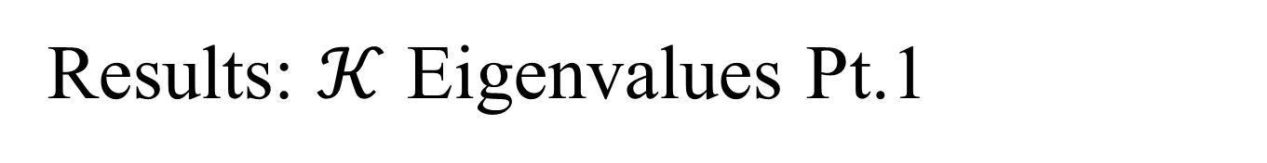
Results: $𝒦$ Eigenvalues Pt.1
Figure 9. The eigen values of the HankelDMD.
Figure 10. The eigen values of the DMD.

Slide 14
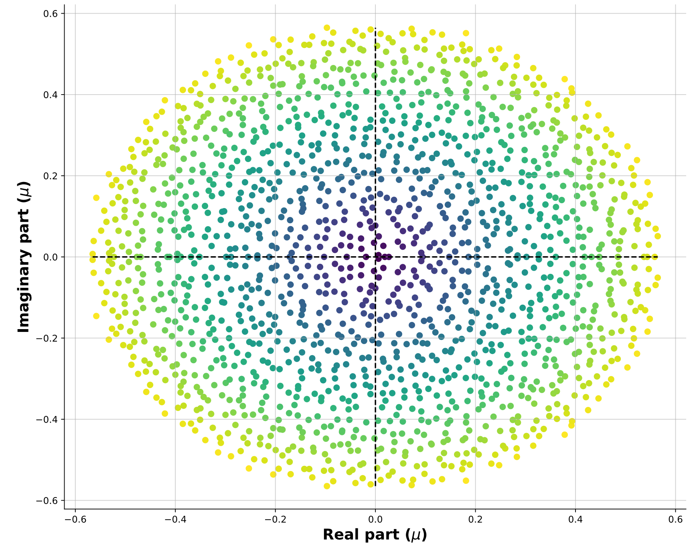
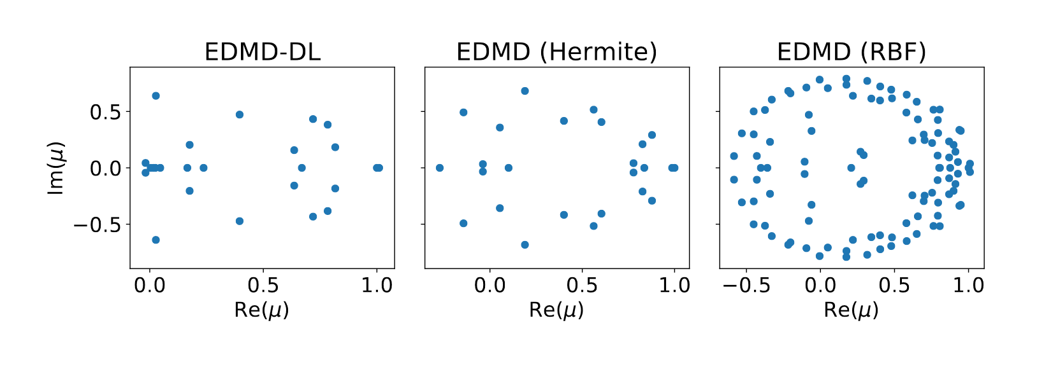
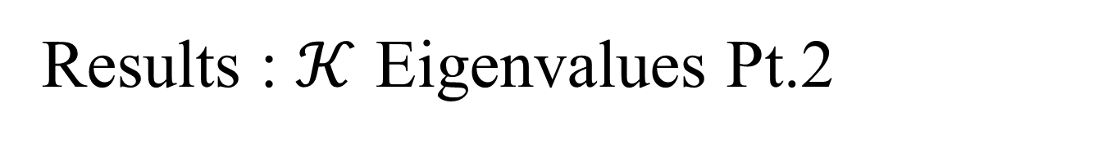
Results : $𝒦$ Eigenvalues Pt.2
Figure 11. Eigen values of the Evolution Matrix (Q. Li, F. Dietrich, E. M. Bollt, and I. G. Kevrekidis)*
*“Extended dynamic mode decomposition with dictionary learning: A data-driven adaptive spectral decomposition of the Koopman operator,”
Figure 12. Eigen values of the Evolution Matrix (Image by Author).

Slide 15

Fin
Thank You
Any Question? 🧐

Slide 16
Introduction: The Koopman Operator
FLOPS

